Slide 1
Introduction to Neurophysiology
- how the nervous system works
Prof. Deepthi de Silva
Department of Physiology
Neurosciences module
D de Silva

Slide 2
At the end of this lecture, you should be able to
state the structure and function of neurons
outline the organisation of the nervous system
outline the role of the nervous system with regard to its sensory, integrative and efferent functions
Revise contents from the foundation & locomotor modules
  Resting membrane potential and action potential
  Nerve conduction in myelinated & unmyelinated fibres
  Types of muscle and how they contract
Neurosciences module
D de Silva

Slide 3
Nervous system
Central nervous system (CNS)
Peripheral nervous system
Brain
Spinal
cord
Somatic
Autonomic
Cortical &
Sub cortical
Sensory
& motor
Sympathetic & parasympathetic
Neurosciences module
D de Silva

Slide 4
Role of the nervous system
Information from outside and inside body is perceived (sensed) by the nervous system
The nervous system
  Receives information
  Decides what action needs to be taken
  Gives the command for the required action
  Checks up if the action performed correctly
Rapid system
Neurosciences module
D de Silva

Slide 5
Neurons
Electrically excitable cells
  Basic unit of nervous system
  100 billion in human central nervous system
Communicate using action potentials
Neurosciences module
D de Silva

Slide 6
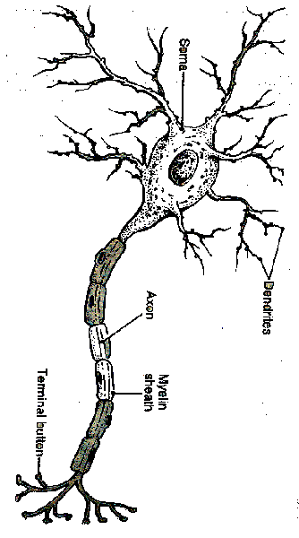
Neurons
Structure
  Cell body
  Dendrites
  Axon
  Terminal buttons
What type of neurone is illustrated?
Give an example where this type of neurone is found
Axon hillock
Initial segment
Axon
Dendrites
Terminal
buttons
Myelin sheath
Node of
Ranvier

Slide 7
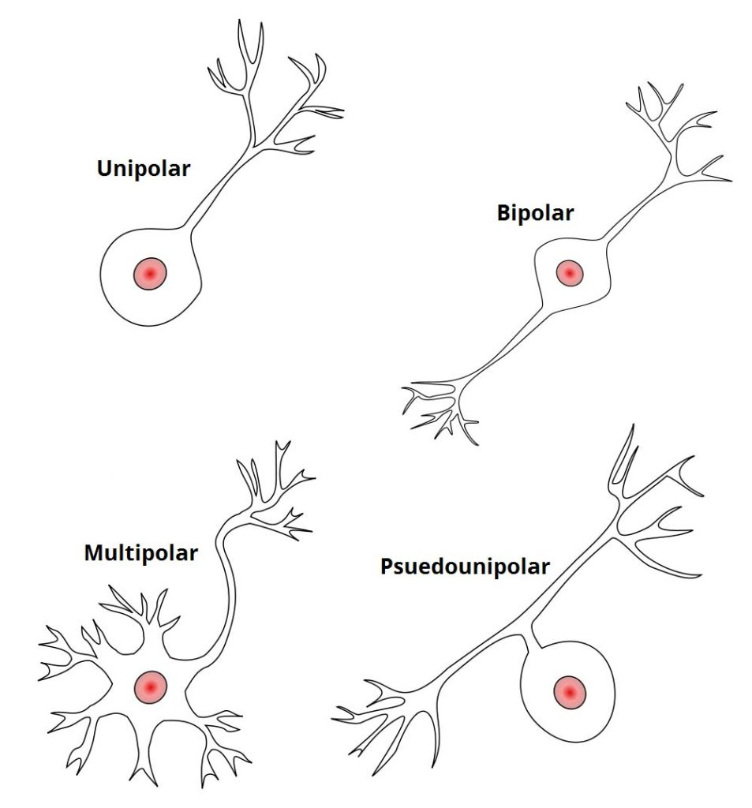
Unipolar –Cell body is at one end of a single unbranched axon, and there are no dendrites. These can be found in the cochlear nucleus of the brain.
Pseudounipolar – They have one axon which is divided into two branches by the presence of the cell body. Sensory neurones are all pseudounipolar.
Bipolar – These neurones have two processes arising from a central cell body – typically one axon and one dendrite. These cells are found in the retina.
Multipolar – They have one axon and many dendrites, with a cell body displaced to one side of the axon. Motor neurones are a prime example of this.
Neurosciences module
D de Silva

Slide 8
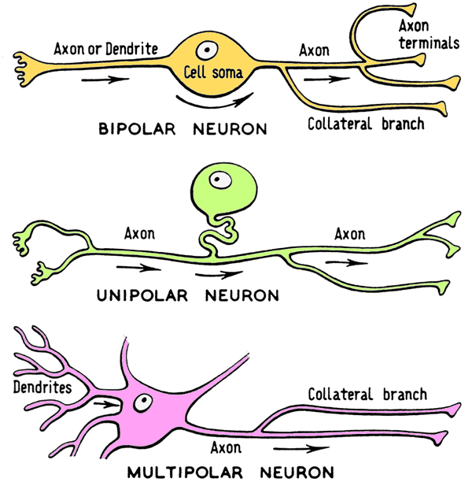
Neurosciences module
D de Silva

Slide 9
Neuronal function
Receptor area –information from other neurons synapse here
  Dendrites (also cell body & axon) act in this way
Area for generating action potentials
  Initial segment or 1st node of Ranvier
Area for transmitting impulses to nerve ending
  Axon acts in this manner
Area for communicating with another cell
  Nerve ending containing terminal buttons releasing neurotransmitter
Neurosciences module
D de Silva

Slide 10
Glial Cells
Not involved in generation or propagation of action potentials
Microglia
  Scavenger cells similar to tissue macrophages
  Remove debris after injury or disease
Macroglia
  Oligodendrocytes & Schwann cells form myelin
  Astrocytes (fibrous in white matter and protoplasmic in grey matter) form connections to capillaries and nerves
  Nutrition provider and forms blood brain barrier

Slide 11
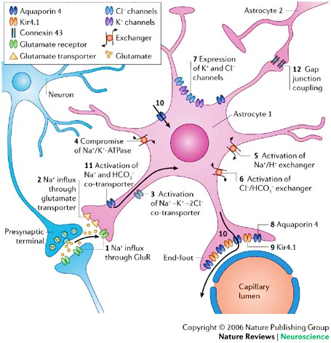

Slide 12

Neurosciences module
D de Silva

Slide 13
Sensation
Sensory/
afferent
functions
Detected by receptor
Afferent sensory neurons
Central nervous system
Process information
Stored
as memory
Immediate
reaction
Motor/
Efferent
functions
Contract skeletal or smooth muscle
Secrete chemicals from glands

Slide 14
Sensory aspects
Different types (modalities) of information
  Light (retina); sound (inner ear); taste (tongue) & touch (skin)
Detected by specific receptors
  Converts different sensory modalities to generate action potentials
Pass information to central nervous system
Neurosciences module
D de Silva

Slide 15
Synapse
Determines the direction of neural impulse
Regulation (control) of impulse transmission
Storage of information occurs at synapses
Neurosciences module
D de Silva

Slide 16
Processing of sensory information
Large amount of information is ignored by the brain
Important information stimulates response
  conscious or unconscious
Storage of information occurs at cerebral cortex and other areas including brain stem & spinal cord
Neurosciences module
D de Silva

Slide 17

Neurosciences module
D de Silva

Slide 18
Processing of information in CNS
Spinal cord level
  walking, some reflexes (e.g. withdrawal)
Sub cortical level
  Regulation of blood pressure
  Respiration
  Behaviour
    Emotions
    Eating and associated reflexes
Cortical level
  Thinking
  Speech
Neurosciences module
D de Silva

Slide 19
Processing information
Convergence
Enormous complexity
Divergence
  single neuron synapses with multiple neurons) and
Convergence
  large number of neurons synapse at a single neuron
Neuronal circuits
  for repetitive actions (e.g. walking)
Divergence
Simple circuit
Neurosciences module
D de Silva

Slide 20
Motor aspects
Different outputs from CNS
  Skeletal muscles
  Smooth muscles
  Regulate secretions from glands
Neurosciences module
D de Silva

Slide 21
Sensation
Sensory/
afferent
functions
Detected by receptor
Afferent sensory neurons
Central nervous system
Process information
Stored
as memory
Immediate
reaction
Motor/
Efferent
functions
Contract skeletal or smooth muscle
Secrete chemicals from glands

Slide 22
Importance of Learning about the Nervous System
Disease burden
  Vascular diseases: Cerebrovascular accidents
  Trauma to brain, spinal cord or nerves
  Demyelinating diseases: multiple sclerosis
  Degeneration: Parkinson & Alzheimer disease
  Alteration of chemicals: e.g. depression
Advances in therapy

Slide 23

Isle of Harris, Scotland
References
Ganong 25th Edition (Chapter 4 p85-96)
Guyton 13th Edition (Chapter 46 p 577-580)
Neurosciences module
D de Silva

